Slide 1
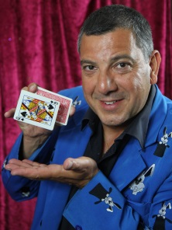
FUN
CHARITY
POKER NIGHT
Live James Bond Themes
Elvis Songs!!
Extreme Business Networking By Theo The Magician
In Association with Cheam Fields
Friday 8th January 2016 - 7pm Which is
Elvis’s Birthday And Theo’s Cheam Fields Tennis, Bowls & Bridge Club, 30 Devon Road, Cheam, Surrey SM2 7PD
Drinks Reception 7.00 - 7.30pm Food Available Everyone receives a Free Drink & Day Pass to Cheam or Westcroft Leisure Centre
Poker School (To teach you how to Play) Fun Competition With Trophies & Prizes Raffle With A Difference (Prizes required - please contact Theo if you are able to donate)
Angelo’s Barbiere
In Aid Of :The Sutton Foodbank – The Sutton Multiple Sclerosis Society – Positive Action for Multiple Sclerosis
Cost: £15 per person if Pre-booked & paid by 2nd January 2016 £20 after that and on the Night if any tickets still available. For a minimum donation of £30 your company can include your Flyers, Cards & Giveaways in each of the 55 Goody Bags. For £40 all the above plus entrance
To Book go direct to:
http://www.magictheo.com/node/510
Or go to
www.magictheo.com
and click
For further info: theo@magictheo.com 07711 724129
Keep up to date on FB “Extreme Business Networking By Theo The Magician” Thank you to businesses that have already helped raise £5,720 for charity
Big Thank You To Our Sponsors
Angelo’s Barbiere 12 Mulgrave Road Sutton SM2 6LE www.ace-accountancy.com
www.schn.org.uk www.thebestof.co.uk/local/epsom-and-ewell

